Slide 1

Research Question –
Tutorial Presentation for Feedback
Date:
Group Name: A136 Name of Student Presenting: Aroosha Rasheed

Slide 2
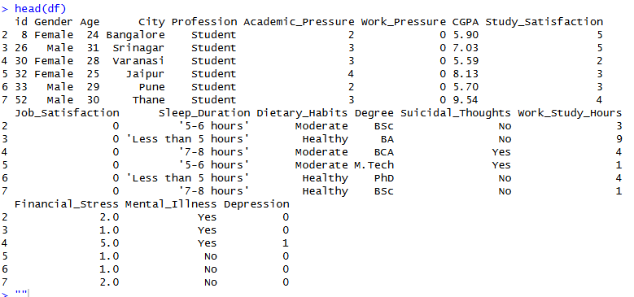
Here is a sample of our dataset (first 5 rows):

Slide 3
Columns chosen for the Research Question:
Academic Score (CGPA) - Dependent Variable
Depression – Independent Variable
Total Rows: 27,901 and 18 columns
Information about Dataset:

Slide 4
This dataset is interesting to us because (one sentence): It relates to student depression and the factors that affect it.
Our Independent variable is: Depression
This Independent variable datatype is (select one): Nominal
Our Dependent variable is: CGPA
This Dependent variable datatype is (select one): Interval
Dataset ID: (ds002 – student_depression_dataset)

Slide 5
Template² :Interval/Ordinal vs Nominal. Data :
Is there a difference in the mean student academic score (CGPA) between depressed and non-depressed students?
Null hypothesis (H₀): There is no difference in the mean/median of the student academic score (CGPA) among depressed and non-depressed students.
Alt hypothesis (H₁): There is a difference in the median CGPA between depressed and non-depressed students.
Our Research Question is:

